Slide 1
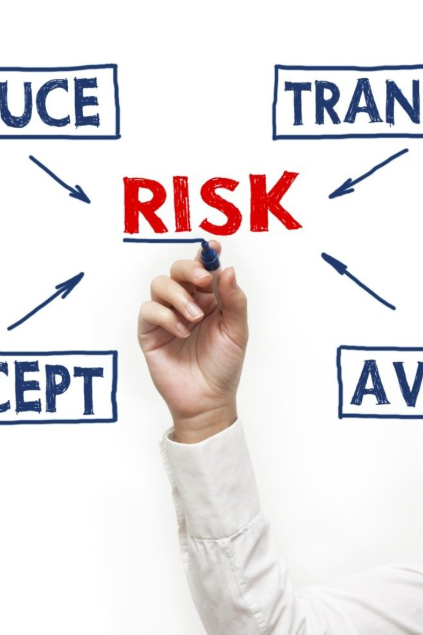
Risk Management
CRM System Implementation
by aya chkioua

Slide 2

Introduction
1
Project Overview
2
Risk Management
The CRM System Implementation project is a strategic initiative by TechSolutions Inc. to enhance customer relations.
Emphasize the importance of proactive risk management for successful project outcomes.

Slide 3
Importance of Risk Management
1
Significance
2
Proactive Management
Discuss the impact of unforeseen events on project timelines and deliverables.
Emphasize that risk management ensures the project stays on track and within budget.

Slide 4
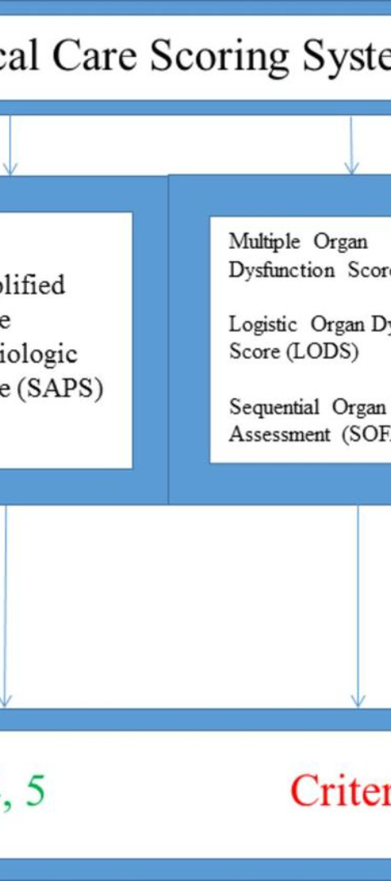
Identification of Potential Risks
1
Risk Identification
Technical Challenges: Potential issues with CRM software integration.
Resource Constraints: Limited availability of skilled personnel.
Data Migration Issues: Challenges in migrating existing data to the new system.

Slide 5
Categorization of Risks
Technical Risks
Human Resources Risks
Operational Risks
Software integration, system compatibility.
Staff availability, skills gaps.
Data migration, system downtime.

Slide 6
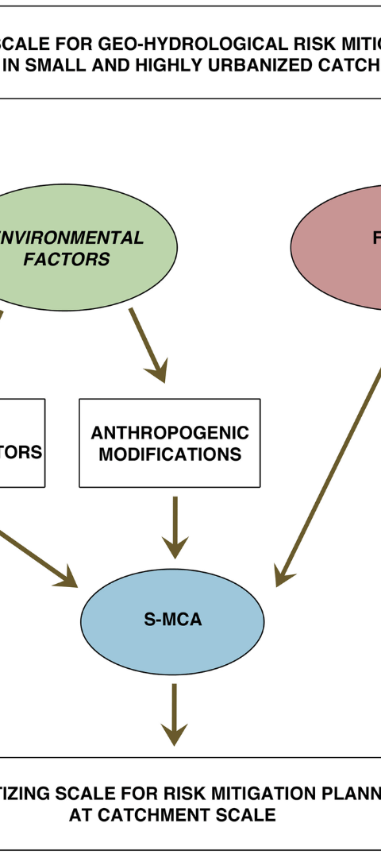
Strategies for Risk Mitigation
1
Technical Risks
Regular testing and prototyping.
2
Human Resources Risks
Cross-training, contingency plans for key personnel.
3
Operational Risks
Thorough data analysis, staged migration.

Slide 7
Risk Impact on Project Outcomes
Technical Risks
Human Resources Risks
Operational Risks
Potential delays in software integration.
Increased workload on available staff.
Temporary disruption in data accessibility.

Slide 8
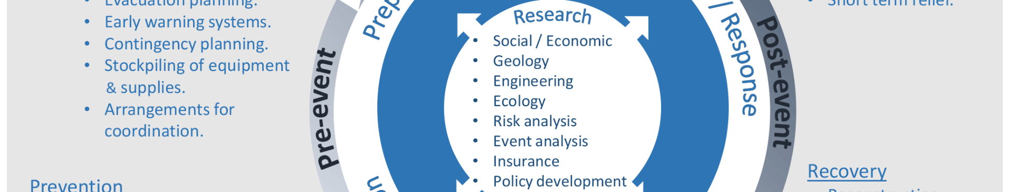
Risk Response Planning
Mitigation Plans
Contingency Plans
Reducing the likelihood or impact of identified risks.
Preparing for potential risk scenarios.

Slide 9
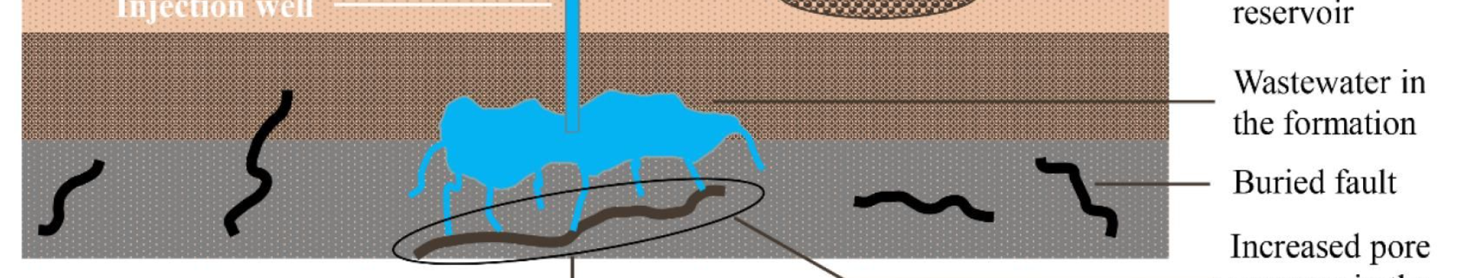


Monitoring and Control
Continuous Monitoring
Feedback Loops
Establish a regular risk monitoring process.
Implement feedback loops to assess the effectiveness of risk mitigation strategies.

Slide 10

Lessons Learned and Continuous Improvement
Reflection :
Discuss lessons learned from risk management activities.
Outline strategies for continuous improvement in identifying, assessing, and mitigating risks.

